Slide 1
Introduction to RDS Datasets
Robin Bowen
Earth Systems Modelling Program
Bureau of Meteorology
ACCESS User Training Course
Melbourne, 21-24 March 2016

Slide 2

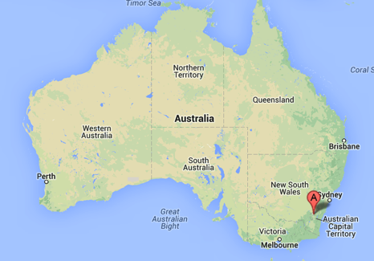


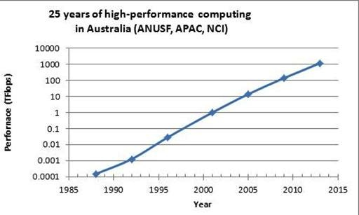

Current Infrastructure: comprehensive, integrated and priority-directed
Compute ($26.5M, 2012-13)
Current Supercomputer, Raijin — Fujitsu Primergy Cluster
1.2 Plops; 1.6 million SPEC_FRB
57,472 cores (Intel Xeon Sandy Bridge, 2.6 GHz)—3592 nodes
~160 TBytes main memory
FDR Infiniband interconnect
~10 PBytes dedicated storage (150 GB/sec bandwidth)
Cloud ($2.3M, 2013)
Australia’s fastest research cloud for data intensive workloads
Dell: 3,200 Intel Xeon cores; FDR IB; 25 TB memory; 160 TB SSD
Storage ($18M, 2010--)
Global storage system IB <-> supercomputer and cloud
~23 PB usable persistent filesystem; 22.6 PB uncompressed tape
25 Years of HPC in Australia from ANU
© National Computational
Infrastructure 2015
Ben Evans, Geoscience Australia, August 2015
nci.org.au

Slide 3

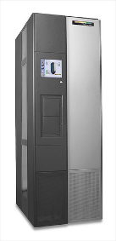



NCI’s integrated high-performance infrastructure
8/58
Internet
NCI data movers
Cloud
Raijin Login + Data movers
Raijin HPC Compute
10 GigE
To Huxley DC
/g/data 56Gb FDR IB Fabric
Raijin 56Gb FDR IB Fabric
Massdata (tape)
Persistent global parallel filesystem
Raijin high-speed filesystem
Cache 1.0PB,
Tape 20 PB
/g/data1
~7.4 PB
/g/data2
~6.75 PB
/g/data3
~9 PB
/short
7.6PB
/home, /system,
/images, /apps
© National Computational
Infrastructure 2015
Ben Evans, Geoscience Australia, August 2015
nci.org.au

Slide 4
Distinctive features of the NCI RDS Node
8/50
Establishing data in a rich environment of high-end computational and data-intensive services.
Making accessible (to the research community) collections that are currently held by national agencies;
Complementing these collections with other nationally and internationally significant collections;
Combining datasets held by research communities into coherent collections
© National Computational
Infrastructure 2015

Slide 5
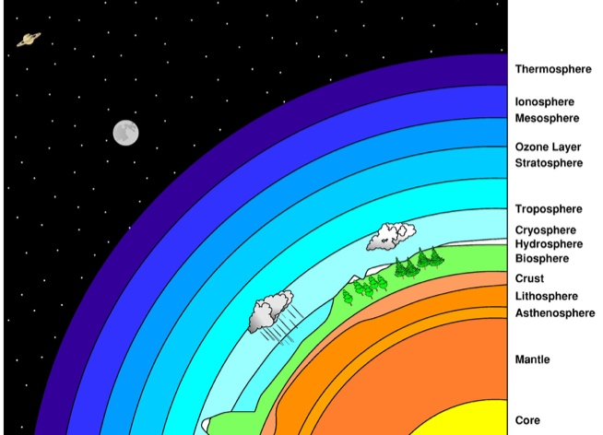
NCI High Performance Data Collections
1. Climate/ESS Model Assets and Data Products
2. Earth and Marine Observations and Data Products
3. Geoscience Collections
4. Terrestrial Ecosystems Collections
5. Water Management and Hydrology Collections
http://geonetwork.nci.org.au/
Data Collections | Approx. Capacity
CMIP5, CORDEX, ACCESS Models | 5 Pbytes
Earth Obs: Himawari-8, LANDSAT, Sentinel, MODIS, INSAR | 2 Pbytes
Digital Elevation, Bathymetry, Onshore/Offshore Geophysics | 1 Pbytes
Seasonal Climate | 700 Tbytes
Bureau of Meteorology Observations | 350 Tbytes
Bureau of Meteorology Ocean-Marine | 350 Tbytes
Terrestrial Ecosystem | 290 Tbytes
Reanalysis products | 100 Tbytes
© National Computational
Infrastructure 2015

Slide 6
Searching for data in NCI’s GeoNetwork catalogue
Click on an entry and it will provide all the information about the data, and the data location on the filesystem or data services

Slide 7
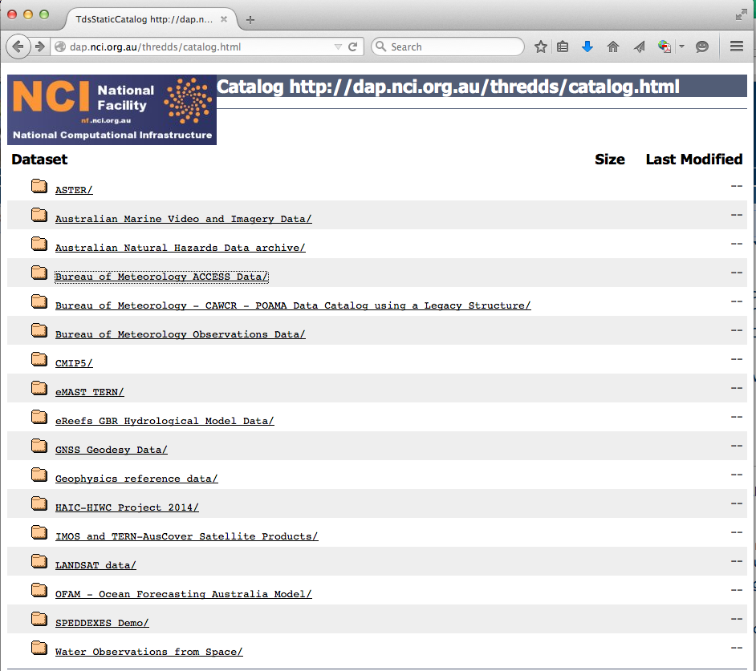
NCI THREDDS Data SERVICE http://dap.nci.org.au
16/58
© National Computational
Infrastructure 2015
Ben Evans, Geoscience Australia, August 2015

Slide 8
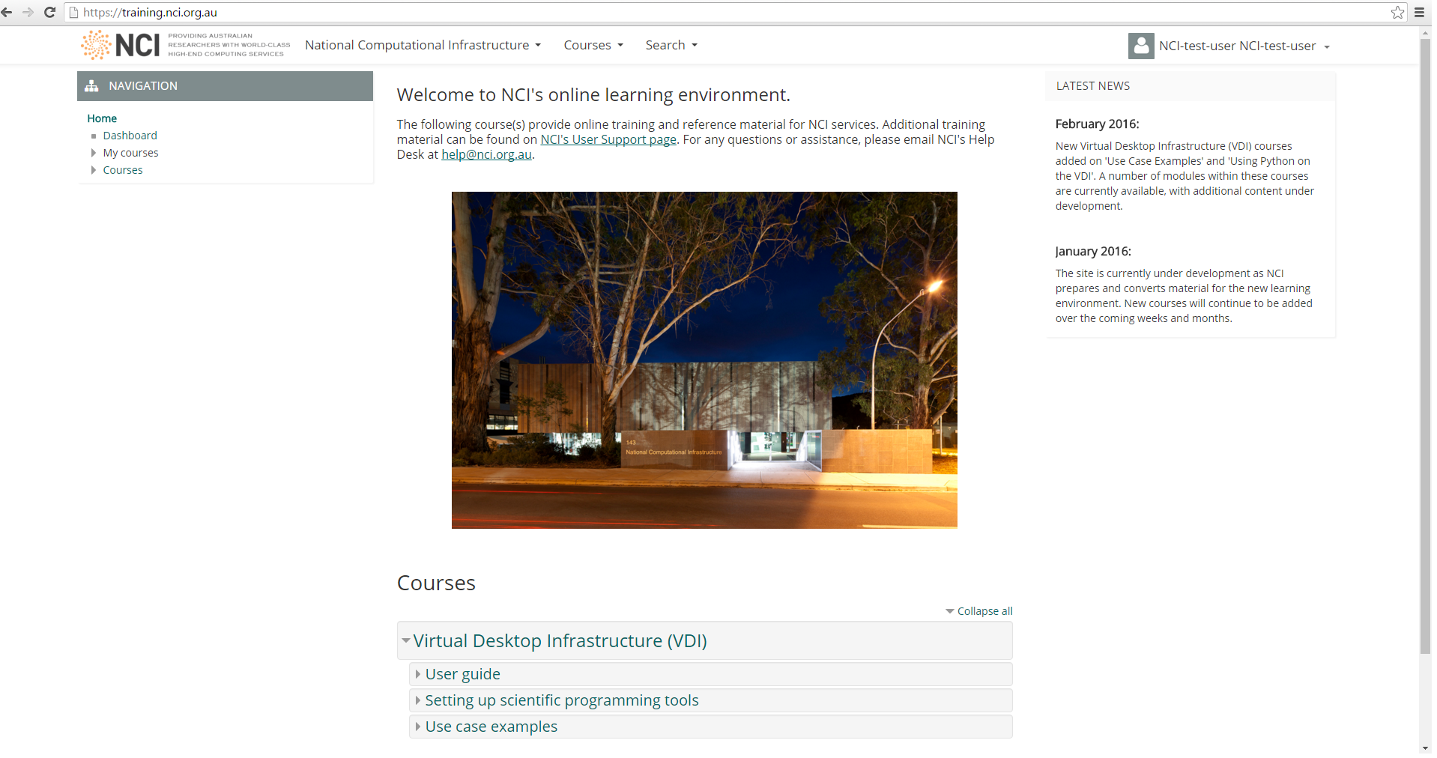
NCI Training http://training.nci.org.au

Slide 9
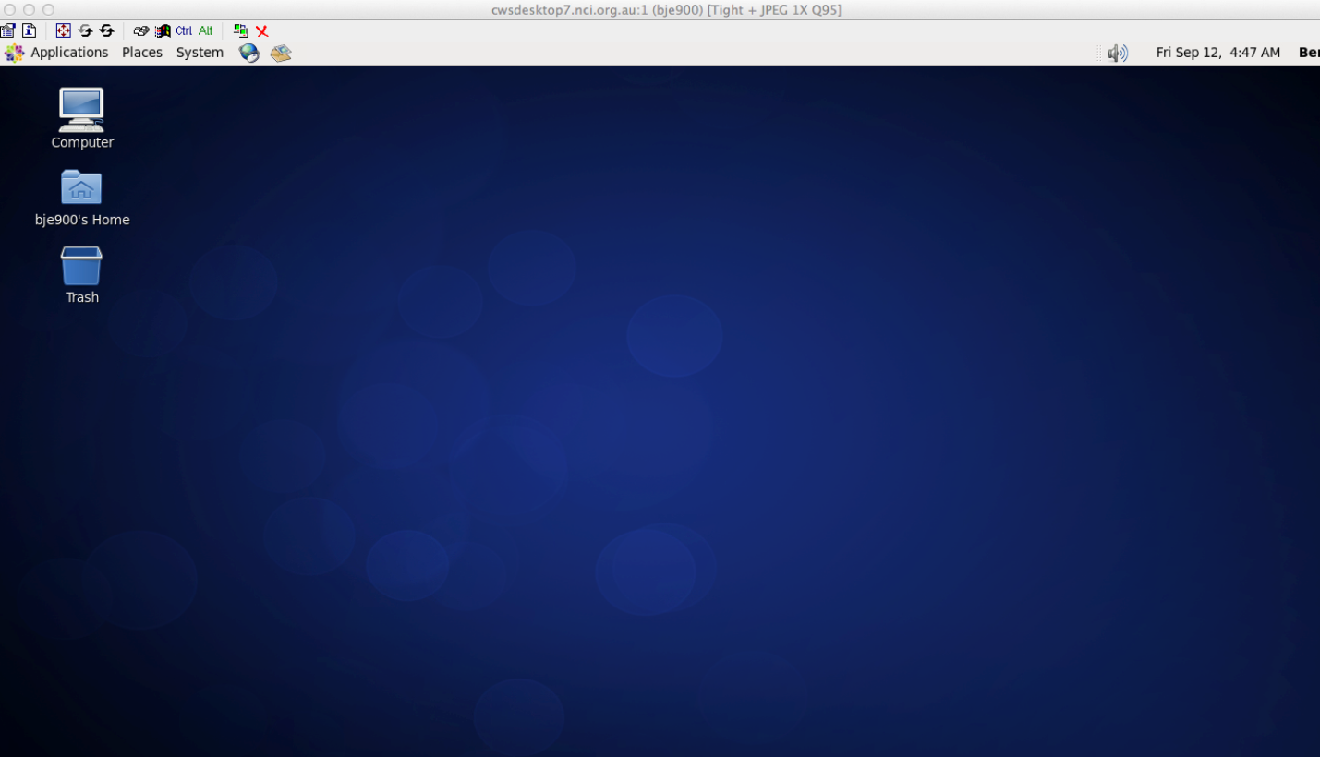
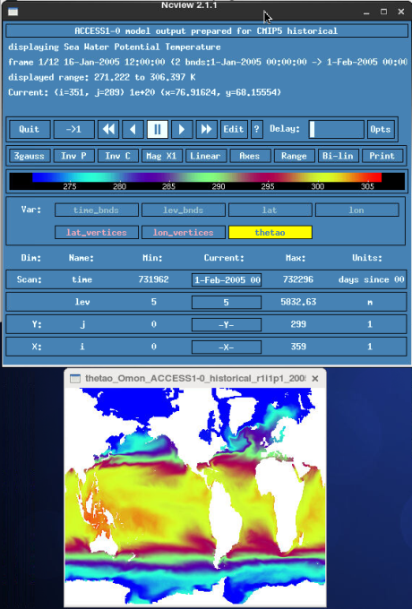
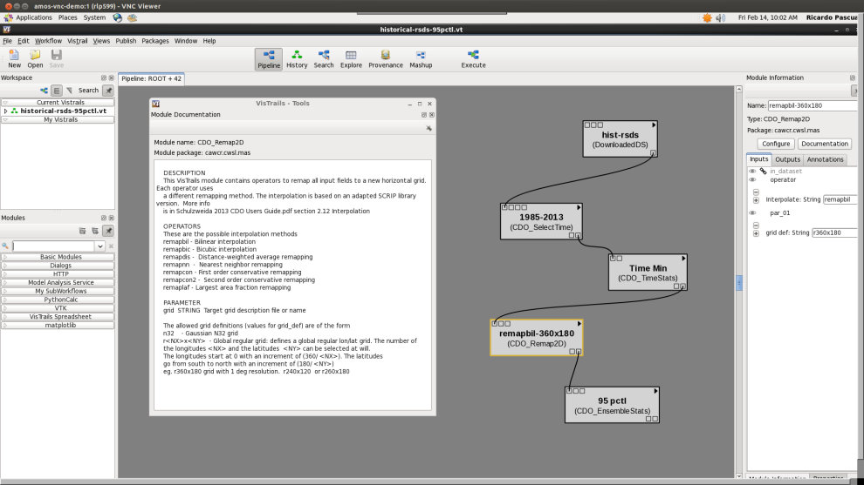
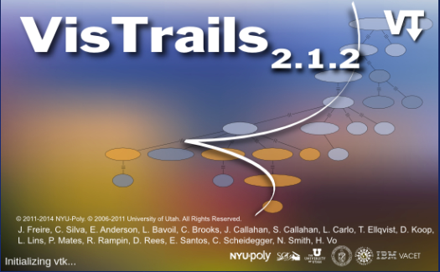
VDI session on NCI HPC cloud: frictionless environment
38/58
© National Computational
Infrastructure 2015
Ben Evans, Geoscience Australia, August 2015

Slide 10
RDS (1)
RDS: Research Data Services project
https://www.rds.edu.au/
(Formerly RDSI: Research Data Storage Initiative)
NCI RDS information
http://nci.org.au/data-collections/data-services-and-access/
Data catalogs
http://nci.org.au/data-collections/data-collections/
http://geonetwork.nci.org.au
http://dap.nci.org.au netcdf format datasets, lists of other format datasets
Raijin:/g/data[1|2|3]/RDS_ProjectID

Slide 11
RDS (2)
ACCESS NWP forecasts and other Bureau of Meteorology datasets are made available to Australian research community via the NCI RDS facility, some dataset examples
rr4 – ACCESS NWP APS0, APS1 analysis and forecasts lb4 – APS2
Meteorological weather analysis and forecast model output using the ACCESS Prediction System since 2009; represents BoM's daily weather predictions
http://geonetwork.nci.org.au/geonetwork/srv/eng/catalog.search#/metadata/f5670_3926_7902_7643
rr7 – Atmospheric reanalysis and observation data from local Australian and international sources such as NCEP1, NCEP2, ERA40, ERA40c and gridded observation data sets such as AWAP for weather and climate research. 2015 ERA Interim, 75 km resolution, 45 different atmospheric variables, one field every 3 hours, WGS84 projection, ECMWF netCDF4 files, Local API and CEPH access

Slide 12
RDS (3)
rr5 – BoM Observations – NWP bufr files used in ACCESS NWP, radar data, satellite data. Himawari-8 satellite data at 500, 1000, 2000 meters (depending on the band), 16 Bands, image every 10 mins, geostationary projection, BoM NetCDF4 files, access through NCI TDS (THREDDS) subsetting
rr8 – BoM Seasonal Climate (POAMA) Hindcasts, 1981 to 2014, 6 days per month
ub7 – ACCESS-S1 (UKMO Global Coupled Model 2) Hindcasts (in progress)
ub3 – High Altitude Ice Crystal (HAIC) – High Ice Water Content (HIWC) field campaign conducted out of Darwin in Jan – Mar 2014, ACCESS NWP, radar, satellite data
fj8 – CSIRO/BoM Key Water Assets – Ouputs of AWRA-L model (v1.0 to v4.5), provides continent-wide estimates of various landscape water balance components and fluxes available from model simulations of the period 1911 to 2011

Slide 13
Questions?
ACCESS User Training Course
Melbourne, 21-24 March 2016

